Slide 1
Econometrics I
September, 2024

Slide 2
Part I
Economic Questions, The Nature of Econometrics and Economic Data

Slide 3
What is Econometrics? (1)
Example 1
The question is ‘’Does reducing class size improve elementary school education?’’
Although the answer of common sense is ‘’yes’’ to this question, an emprical evidence should also be provided. This is done by basing on data which relates class size to basic learning.
Stock&Watson (Chapter 1)

Slide 4
What is Econometrics? (2)
Example 2
The question is ‘’Is there racial discrimination in the market for home loans?’’
Lending institutions should not take race into account when deciding to grant or deny a request for home loan.
However, a research for US showes that 28% of black applicants are denied, while only 9% of white applicants are denied.
Data must be examined to see if there is a difference in the probability of being denied for otherwise identical applicants.
Stock&Watson (Chapter 1)

Slide 5
What is Econometrics? (3)
Example 3
The question is ‘’How much do cigarette taxes reduce smoking?’’
There is a role for government in reducing cigarette consumption. One of the tools for cutting consumption is to increase taxes on cigarettes.
Remember that the percentage change in the quantity demanded resulting from a 1% increase in price is the price elasticity of demand.
What is the price elasticity of demand for cigarettes?
To learn the elasticity, an analysis should be done on cigarette consumption and prices.
Stock&Watson (Chapter 1)

Slide 6
What is Econometrics? (4)
Example 4
People are always interested in future.
One aspect of the future in which macroeconomists and financial economists are interested is the rate of overall price inflation during the next year.
A financial professional might advice a client whether to make a loan or to take one out at a given rate of interest, depending on guess of the rate of inflation over the coming year.
The financial professional who rely on precise numerical forecasts use econometric models to make those forecasts.
Stock&Watson (Chapter 1)

Slide 7
What is Econometrics? (5)
Example 5
You are hired by your state government to evaluate the effectiveness of a publicly funded job training program.
This program teaches workers various ways to use computers in the manufacturing process.
You are to determine what, if any, effect the training program has on each worker’s job performance.
Woolridge (Chapter 1)

Slide 8
What is Econometrics? (6)
Example 6
You work for an investment bank.
You are to study the returns on different investment strategies involving short-term treasury bills to decide whether they comply with implied economic theories.
Woolridge (Chapter 1)

Slide 9
What is Econometrics? (7)
Example 7
The question is to find out how the average height of sons changes, given the fathers’ height.
For this, the data about both the hights of fathers and sons are needed.
Gujarati&Porter, 2008 (Introduction)

Slide 10
What is Econometrics? (8)
Example 8
Remember that marginal propensity to consume (MPC) is average change in consumption expenditure for a lira’s worth of change in real income.
An economist may be interested in estimating this MPC, that is studying the dependence of personal consumption expenditure on aftertax or disposable real personal income.
Gujarati&Porter, 2008 (Introduction)

Slide 11
What is Econometrics? (9)
Example 9
A labor economist may want to study the rate of change of money wages in relation to the unemployment rate.
Remember that the historical data produces the Phillips curve relating changes in the money wages to the unemployment rate.
Such a data may enable the labor economist to predict the average change in money wages given a certain unemployment rate.
Such knowledge may be helpful in stating something about the inflationary process in an economy, for increases in money wages are likely to be reflected in increased prices.
Gujarati&Porter, 2008 (Introduction)

Slide 12
What is Econometrics? (10)
Example 10
The marketing director of a company may want to know how the demand for the company’s product is related to advertising expenditure.
Such a study will be of considerable help in finding out the elasticity of demand with respect to advertising expenditure, that is, the percent change in demand in response to, say, a 1 percent change in the advertising budget.
This knowledge may be helpful in determining the “optimum” advertising budget.
Gujarati&Porter, 2008 (Introduction)

Slide 13
What is Econometrics? (11)
Example 11
An agronomist may be interested in studying the dependence of a particular crop yield, say, of wheat, on temperature, rainfall, amount of sunshine, and fertilizer.
Such a dependence analysis may enable the prediction or forecasting of the average crop yield, given information about the above variables.
Gujarati&Porter, 2008 (Introduction)

Slide 14
What is Econometrics? (12)
Each of these eleven questions requires a numerical answer. Economic theory provides clues about that answer.
For example, theory says cigarette consumption ought to go down when the price goes up.
However, the actual value of the number must be learned empirically by analyzing data.
Because we use data to answer quantitative questions, our answers always have some uncertainty. A different set of data would produce a different numerical answer.

Slide 15
What is Econometrics? (12)
Econometrics is based upon the development of statistical methods for estimating economic relationships, testing economic theories, and evaluating and implementing government and business policy. This is done by analyzing economic data.
The most common application of econometrics is the forecasting of such important macroeconomic variables as interest rates, inflation rates, and gross domestic product.
However, econometric methods can also be used in many other branches of economics as well. For example,
  finance
  labor economics
  microeconomics
  marketing
  economic policy
Econometric methods can also be used in areas that have nothing to do with above stated topics. For example,
  political campaign expenditures on voting outcomes.
  the effect of school spending on student performance in the field of education.
  Stock&Watson (Chapter 1), Woolridge (Chapter 1)
Woolridge (Chapter 1)

Slide 16
Methodology of Econometrics? (1)
Statement of theory or hypothesis.
Specification of the mathematical model of the theory. D=c + bP
Specification of the statistical, or econometric, model. D=c + bP + epsilon
Obtaining the data.
Choose the methodology of econometrics.
Estimation of the parameters of the econometric model.
Hypothesis testing.
Forecasting or prediction.
Using the model for control or policy purposes.
Gujarati&Porter, 2008 (Introduction)

Slide 17
Methodology of Econometrics? (2)
Example of a Statement of Theory or Hypothesis
Keynes postulated that the marginal propensity to consume (MPC), the rate of change of consumption for a unit (say, a dollar) change in income, is greater than zero but less than 1.
Gujarati&Porter, 2008 (Introduction)

Slide 18
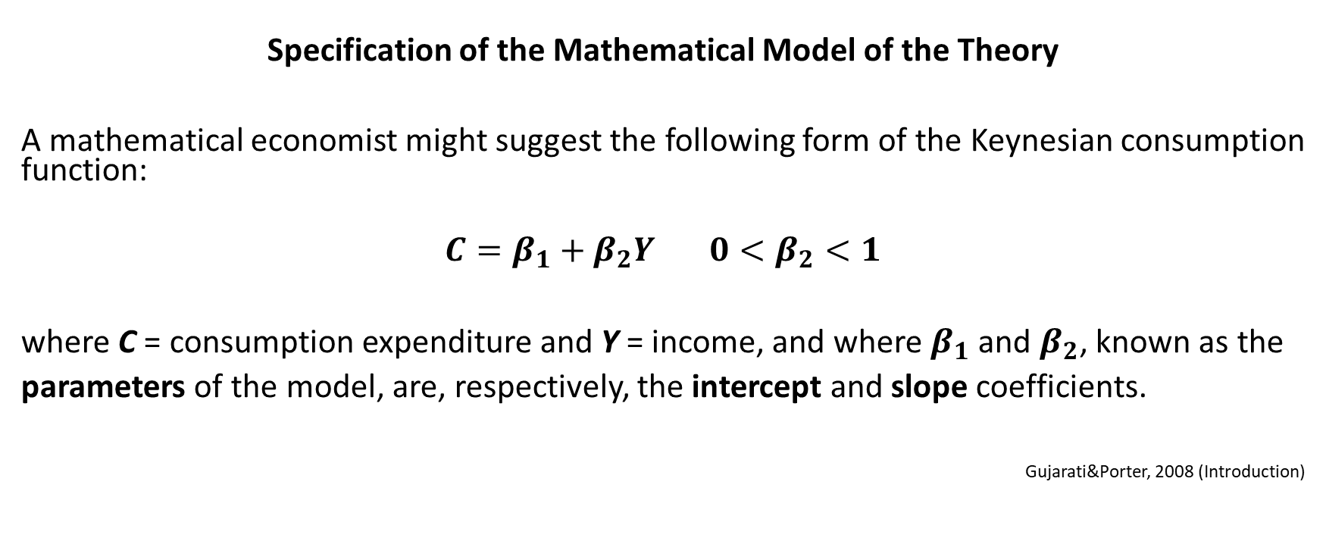
Methodology of Econometrics? (3)
Specification of the Mathematical Model of the Theory
A mathematical economist might suggest the following form of the Keynesian consumption function:
$$C=β_{1}+β_{2}Y 0<β_{2}<1$$
where C = consumption expenditure and Y = income, and where $β_{1}$ and $β_{2}$, known as the
parameters of the model, are, respectively, the intercept and slope coefficients.
Gujarati&Porter, 2008 (Introduction)

Slide 19
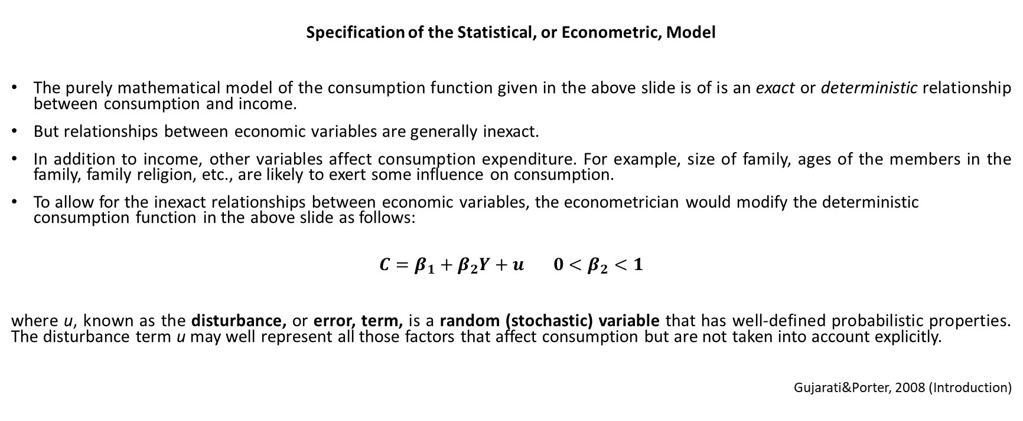
Methodology of Econometrics? (4)
Specification of the Statistical, or Econometric, Model
The purely mathematical model of the consumption function given in the above slide is of is an exact or deterministic relationship between consumption and income.
But relationships between economic variables are generally inexact.
In addition to income, other variables affect consumption expenditure. For example, size of family, ages of the members in the family, family religion, etc., are likely to exert some influence on consumption.
To allow for the inexact relationships between economic variables, the econometrician would modify the deterministic consumption function in the above slide as follows:
$$C=β_{1}+β_{2}Y+u 0<β_{2}<1$$
where u, known as the disturbance, or error, term, is a random (stochastic) variable that has well-defined probabilistic properties. The disturbance term u may well represent all those factors that affect consumption but are not taken into account explicitly.
Gujarati&Porter, 2008 (Introduction)

Slide 20
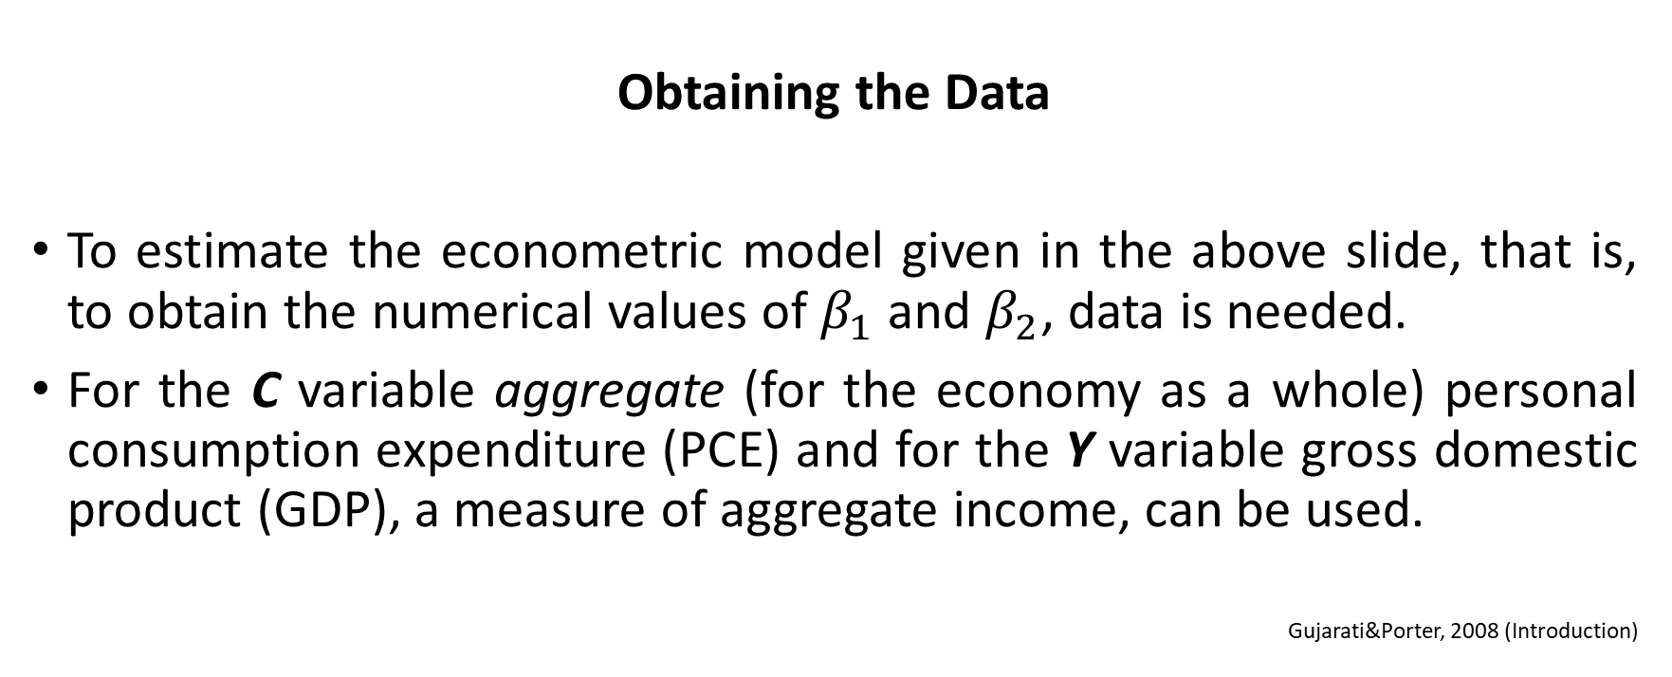
Methodology of Econometrics? (5)
Obtaining the Data
To estimate the econometric model given in the above slide, that is, to obtain the numerical values of $β_{1}$ and $β_{2}$, data is needed.
For the C variable aggregate (for the economy as a whole) personal consumption expenditure (PCE) and for the Y variable gross domestic product (GDP), a measure of aggregate income, can be used.
Gujarati&Porter, 2008 (Introduction)

Slide 21
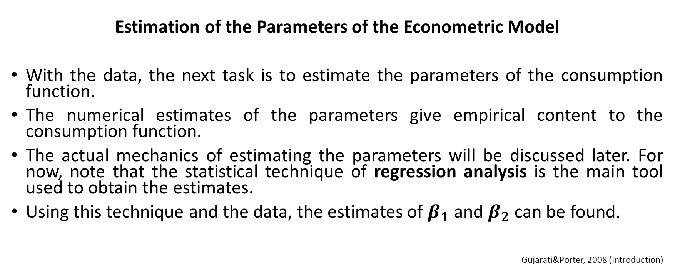
Methodology of Econometrics? (6)
Estimation of the Parameters of the Econometric Model
With the data, the next task is to estimate the parameters of the consumption function.
The numerical estimates of the parameters give empirical content to the consumption function.
The actual mechanics of estimating the parameters will be discussed later. For now, note that the statistical technique of regression analysis is the main tool used to obtain the estimates.
Using this technique and the data, the estimates of $β_{1}$ and $β_{2}$ can be found.
Gujarati&Porter, 2008 (Introduction)

Slide 22
Methodology of Econometrics? (7)
Hypothesis Testing
Assuming that the fitted model is a reasonably good approximation of reality, we have to develop suitable criteria to find out whether the estimates obtained are in accord with the expectations of the theory that is being tested.
As noted earlier, Keynes expected the MPC to be positive but less than 1. Therefore, this is what is to be tested.
Such confirmation of economic theories on the basis of sample evidence is based on a branch of statistical theory known as statistical inference (hypothesis testing) which will be studied later.
Gujarati&Porter, 2008 (Introduction)

Slide 23
Methodology of Econometrics? (8)
Forecasting or Prediction
If the chosen model does not reject the hypothesis or theory under consideration, we may use it to predict the future value(s) of the dependent variable which is for our example is the consumption.
Gujarati&Porter, 2008 (Introduction)

Slide 24
Methodology of Econometrics? (9)
Using the Model for Control or Policy Purposes
The estimated model may be used for control, or policy, purposes.
The government or other related institutions are the ones who will use these estimates.
Gujarati&Porter, 2008 (Introduction)

Slide 25
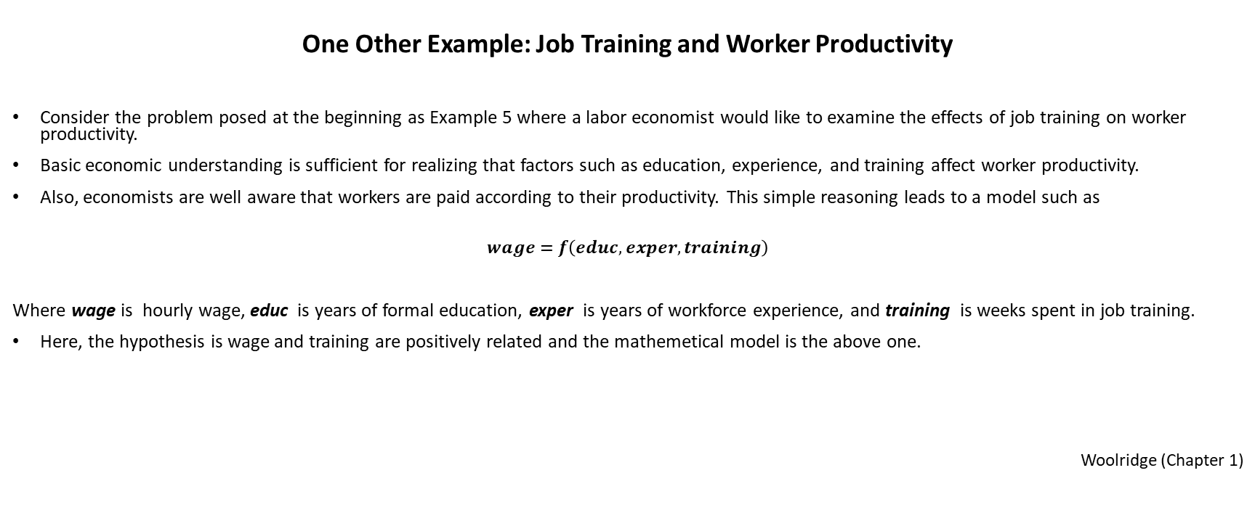
Methodology of Econometrics? (10)
One Other Example: Job Training and Worker Productivity
Consider the problem posed at the beginning as Example 5 where a labor economist would like to examine the effects of job training on worker productivity.
Basic economic understanding is sufficient for realizing that factors such as education, experience, and training affect worker productivity.
Also, economists are well aware that workers are paid according to their productivity. This simple reasoning leads to a model such as
$$wage=f\left(educ, exper, training\right)$$
Where wage is hourly wage, educ is years of formal education, exper is years of workforce experience, and training is weeks spent in job training.
Here, the hypothesis is wage and training are positively related and the mathemetical model is the above one.
Woolridge (Chapter 1)

Slide 26
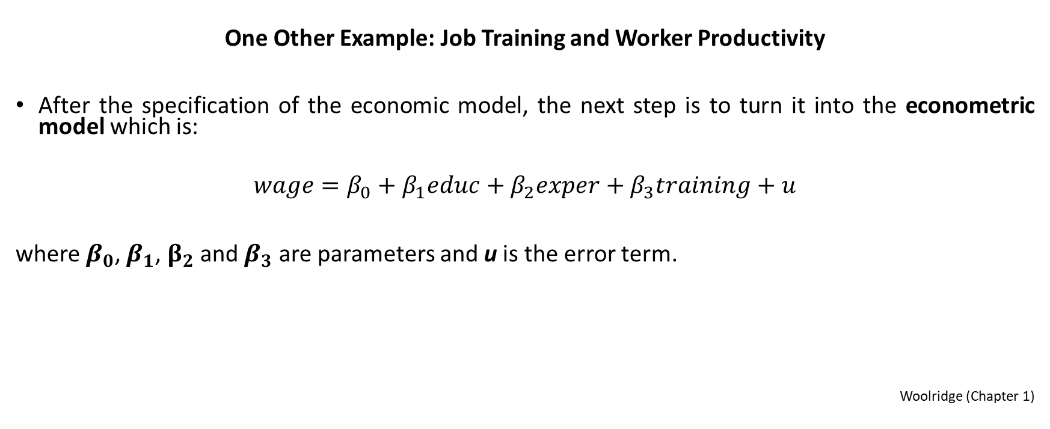
Methodology of Econometrics? (11)
One Other Example: Job Training and Worker Productivity
After the specification of the economic model, the next step is to turn it into the econometric model which is:
$$wage=β_{0}+β_{1}educ+β_{2}exper+β_{3}training+u$$
where $β_{0}$, $β_{1}$, $β_{2}$and $β_{3}$ are parameters and u is the error term.
Woolridge (Chapter 1)

Slide 27
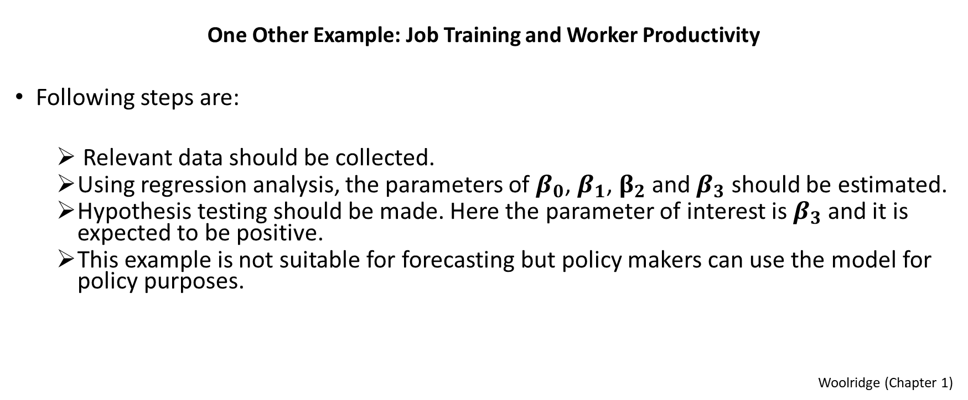
Methodology of Econometrics? (12)
One Other Example: Job Training and Worker Productivity
Following steps are:
  Relevant data should be collected.
  Using regression analysis, the parameters of $β_{0}$, $β_{1}$, $β_{2}$and $β_{3}$ should be estimated.
  Hypothesis testing should be made. Here the parameter of interest is $β_{3}$ and it is expected to be positive.
  This example is not suitable for forecasting but policy makers can use the model for policy purposes.
Woolridge (Chapter 1)

Slide 28
Causal Effects (1)
An action is said to cause an outcome if the outcome is the direct result, or consequence, of that action. In other words, causality means that a specific action leads to a specific consequences. One can give the below two daily life examples:
  touching a hot cup causes you to get burned,
  drinking water causes you to be less thursty,
Check whether there is causality for the 11 examples of economics given in previous slides.
Stock&Watson (Chapter 1)

Slide 29
Causal Effects (2)
Time does not Run Backward
Sequence of time can be a clue to determine the direction of causality.
If event A happens before event B, then it is possible that A is causing B. However, it is not possible that B is causing A.
Gujarati, 2011 (Chapter 16)

Slide 30
Causal Effects (3)
Notion of Ceteris Paribus
The notion of ceteris paribus—which means “other (relevant) factors being equal”— plays an important role in causal analysis.
Remember from introductory economics that most economic questions are ceteris paribus by nature. For example, in analyzing consumer demand, the effect of changing the price of a good on its quantity demanded is investigated while holding all other factors such as income, prices of other goods, and individual tastes fixed.
If other factors are not held fixed, the causal effect of a price change on quantity demanded cannot be known.
Woolridge (Chapter 1)

Slide 31
Causal Effects (4)
Job Training and Worker Productivity Example Once Again with the Notion of Ceteris Paribus
In the job training example, the interest is in the effect of another week of job training on wages, with all other components, that is education and experience, being equal.
If all other relevant factors can be hold fixed and then a link between job training and wages can be found, a conclusion can be reached stating that job training has a causal effect on worker productivity.
Woolridge (Chapter 1)

Slide 32
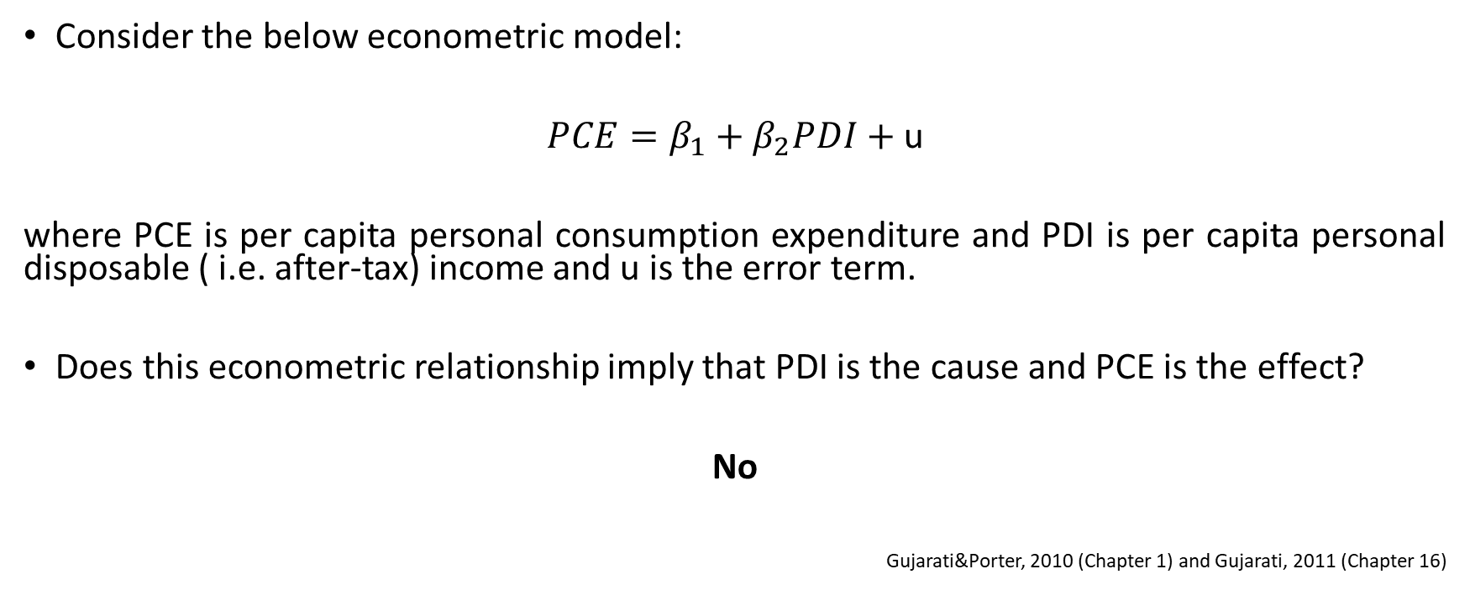
Causal Effects (5)
Consider the below econometric model:
$PCE=β_{1}+β_{2}PDI+$ u
where PCE is per capita personal consumption expenditure and PDI is per capita personal disposable ( i.e. after-tax) income and u is the error term.
Does this econometric relationship imply that PDI is the cause and PCE is the effect?
No
Gujarati&Porter, 2010 (Chapter 1) and Gujarati, 2011 (Chapter 16)

Slide 33
Causal Effects (6)
“A statistical relationship … can never establish causal connection…”
M.G Kendall & A. Stuart, The Advanced Theory of Statistics (1961), pg. 279
If causality between the two exists, it must be justified on the basis of some economic theory.
For example, the quantity demanded of a commodity is inversely dependent on its own price. Here microeconomic theory suggests that the price may be the causal force and quantity demanded the effect.
Gujarati&Porter, 2010 (Chapter 1)

Slide 34
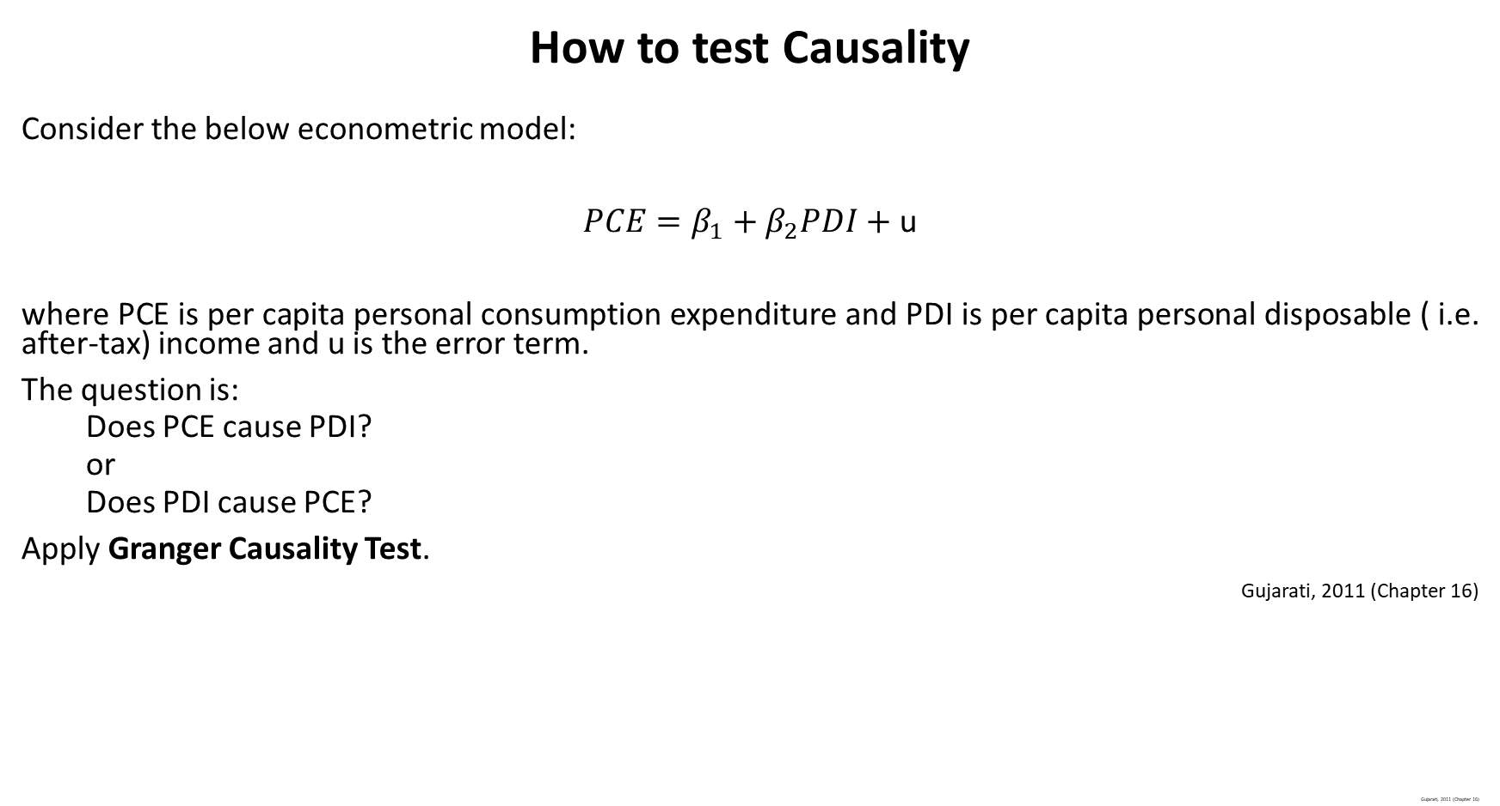
Causal Effects (6)
How to test Causality
Consider the below econometric model:
$PCE=β_{1}+β_{2}PDI+$ u
where PCE is per capita personal consumption expenditure and PDI is per capita personal disposable ( i.e. after-tax) income and u is the error term.
The question is:
  Does PCE cause PDI?
  or
  Does PDI cause PCE?
Apply Granger Causality Test.
Gujarati, 2011 (Chapter 16)
Gujarati, 2011 (Chapter 16)

Slide 35
Causality (7)
Kahneman and Tversky stated the below two statements and asked to several people which one is less likely to occure.
The Black Swan, Nassim Nicholas Talep, pg. 76 - 77

Slide 36
Causality (8)
A massive flood somewhere in America in which more than a thousand people die.
An earthquake in California, causing massive flooding, in which more than a thousand people die.
Respondents stated that the first event was less likely than the second.
The Black Swan, Nassim Nicholas Talep, pg. 76 - 77

Slide 37
Causality (9)
Consider the two questions:
How many cases of lung cancer are likely to take place in Türkiye?
Many cases of lung cancer are likely to take place because of smoking. How many cases of lung cancer are likely to take place in Türkiye?
It is more probable that the number given to the second question will be higher due to because.
The Black Swan, Nassim Nicholas Talep, pg. 76 - 77

Slide 38
Causality (10)
From the example of E. M. Foster one can ask the question which of the below two statements are more likely.
Joey seemed happily married. He killed his wife.
Joey seemed happily married. He killed his wife to get her inheritance.
Second statement seems more likely which is a pure mistake of logic since the first can accomadete more causes such as being mad or being cheated with someone.
The Black Swan, Nassim Nicholas Talep, pg. 76 - 77

Slide 39
Data Sources (1)
Experimental Data
Observational Data
Stock&Watson (Chapter 1)

Slide 40
Data Sources (2)
Experimental Data (1)
This data come from experiments designed to evaluate a treatment or policy.
Experimental data are mostly collected by natural sciences.
The investigator may want to collect data while holding certain factors constant in order to assess the impact of some factors on a given phenomenon.
  Ex: In assessing the impact of obesity on blood pressure, the researcher would want to collect data while holding constant the eating, smoking, and drinking habits of the people in order to minimize the influence of these variables on blood pressure.
Stock&Watson (Chapter 1), Gujarati&Porter (Chapter 1)

Slide 41
Data Sources (3)
Experimental Data (2)
An example is presented in Stock&Watson Chapter 13.
The state of Tennessee financed a large randomized controllled experiment examining class size in the 1980s.
Thousands of students were randomly assigned to classes of different sizes for several years and were given annual standardized tests.
Stock&Watson (Chapter 1)

Slide 42
Data Sources (4)
Experimental Data (3)
This experiment cost millions of dollars and required the ongoing cooperation of many administrators, parents, and teachers over several years.
Stock&Watson (Chapter 1)

Slide 43
Data Sources (5)
Experimental Data (4)
Marshmallow Test

Slide 44
Data Sources (6)
Observational Data (1)
This is the data obtained by observing actual behavior outside an experimental setting.
Observational data are collected using
  surveys
  administrative records
    governmental agencies (eg: TurkStat, TCMB)
    international agencies (eg: World Bank)
    private organizations
Stock&Watson (Chapter 1)

Slide 45
Data Sources (6)
Observational Data (2)
Reasons for bad quality of data:
There is the possibility of observational errors.
In questionnaire-type surveys, the problem of nonresponse can be serious.
The sampling methods used in obtaining the data may vary so widely that it is often difficult to compare the results obtained from the various samples.
Economic data are generally available at a highly aggregate level. For example, most macrodata (e.g., GNP, employment, inflation, unemployment) are available for the economy as a whole or at the most for some broad geographical regions. Such highly aggregated data may not tell us much about the individuals or microunits that may be the ultimate object of study.
Gujarati&Porter (Chapter 1)

Slide 46
Data Types (1)
Cross-Sectional Data
Time Series Data
Panel Data
Stock&Watson(Chapter 1)

Slide 47
Data Types (2)
Cross-Sectional Data (1)
Data on different entities – individuals, workers, consumers, firms, governmental units, households, cities, states, countries and so forth – for a single time period are called cross-sectional data.
Stock&Watson(Chapter 1), Woolridge (Chapter 1)

Slide 48
Data Types (3)
Cross-Sectional Data (2)
An important feature of cross-sectional data is that we can often assume that they have been obtained by random sampling from the underlying population.
For example, if we obtain information on wages, education, experience, and other characteristics by randomly drawing 500 people from the working population, then we have a random sample from the population of all working people.
Woolridge (Chapter 1)

Slide 49
Data Types (4)
Cross-Sectional Data (3)
Sometimes, random sampling is not appropriate as an assumption for analyzing cross-sectional data.
For example, suppose the interest is in studying factors that influence the accumulation of family wealth. A random sample of families can be surveyed, but some families might refuse to report their wealth. If, for example, wealthier families are less likely to disclose their wealth, then the resulting sample on wealth is not a random sample from the population of all families.
Woolridge (Chapter 1)

Slide 50
Data Types (5)
Cross-Sectional Data (4)
Cross-sectional data are widely used in economics and other social sciences.
In economics, the analysis of cross-sectional data is closely aligned with the applied microeconomics fields, such as
  labor economics,
  state and local public finance,
  industrial organization,
  urban economics,
  demography,
  health economics.
Woolridge (Chapter 1)

Slide 51
Data Types (6)
Cross-Sectional Data (5)
The data on test scores in California school districts are cross-sectional. Those data are for 420 entities (school districts) for a single time period (1999).
Stock&Watson(Chapter 1)

Slide 52
Data Types (7)
Cross-Sectional Data (6)
Selected Observations on Test Scores and Other Variables for California School Districts in 1999
Stock&Watson (Chapter 1)
Observation (District) Number | District Average Test Score | Student – Teacher Ratio | Expenditure per Pupil ($) | Percentage of Students Learning English (%)
1 | 690.8 | 17.89 | 6385 | 0.0
2 | 661.2 | 21.52 | 5099 | 4.6
⁞ | ⁞ | ⁞ | ⁞ | ⁞
419 | 672.2 | 20.20 | 4776 | 3.0
420 | 655.8 | 19.04 | 5993 | 5.0

Slide 53
Data Types (8)
Time Series Data (1)
Time series data are data for a single entity (person, firm, country) collected at multiple time periods.
Examples of time series data include
  stock prices,
  money supply,
  consumer price index,
  gross domestic product,
  annual homicide rates,
  automobile sales figures.
Because past events can influence future events time is an important dimension in a time series data set.
Unlike the arrangement of cross-sectional data, the chronological ordering of observations in a time series conveys potentially important information.
Stock&Watson (Chapter 1), Woolridge (Chapter 1)

Slide 54
Data Types (9)
Time Series Data (2)
Another feature of time series data that can require special attention is the data frequency at which the data are collected.
In economics, the most common frequencies are daily, weekly, monthly, quarterly, and annually.
  Stock prices and weather reports are recorded at daily intervals.
  The money supply is reported weekly.
  Inflation and unemployment rates are tabulated monthly.
  Gross domestic product is recorded every three months (every quarter).
  Infant mortality rates and government budgets for countries are available on an annual basis.
Woolridge (Chapter 1)

Slide 55
Data Types (10)
Time Series Data (3)
Stock&Watson (Chapter 1)
GDP per Capita (Turkey, $)
1990 | 10723.62
1991 | 10620.56
1992 | 10974,71
1993 | 11627.36
1994 | 10911.35
1995 | 11588.17
1996 | 12250.71
1997 | 12976.03
1998 | 13072.91
1999 | 12443.08
2000 | 13090.30
2001 | 12166.19
2002 | 12732.94
2003 | 13217.18
2004 | 14258.47
2005 | 15251.65
2006 | 16093.19
2007 | 16633.60
2008 | 16536.88
2009 | 15544.96
2010 | 16757.53
2011 | 17997.82
2012 | 18147.60
2013 | 18646.78

Slide 56
Data Types (11)
Panel Data (1)
Panel data, also called longitudinal data, are data for multiple entities in which each entity is observed at two or more time periods.
Some examples are
  Wage, education, and employment history for a set of individuals followed over a ten-year period,
  Investment and financial data, about the same set of firms over a five-year time period.
Stock&Watson (Chapter 1), Woolridge (Chapter 1)

Slide 57
Data Download (1)
World Bank
www.worldbank.org
Data
Indicators
Databank
World Development Indicators

Slide 58
Data Download (2)
Turkish Statistical Institute (TurkStat)
www.turkstat.gov.tr
Statistical Indicators
Main Statistics
Press Releases

Slide 59
Data Download (3)
Turkish Central Bank
www.tcmb.gov.tr
Choose English
Statistics
Publications

