Slide 1
Artificial Intelligance (AI) and Digital Tools
March 2025

Slide 2
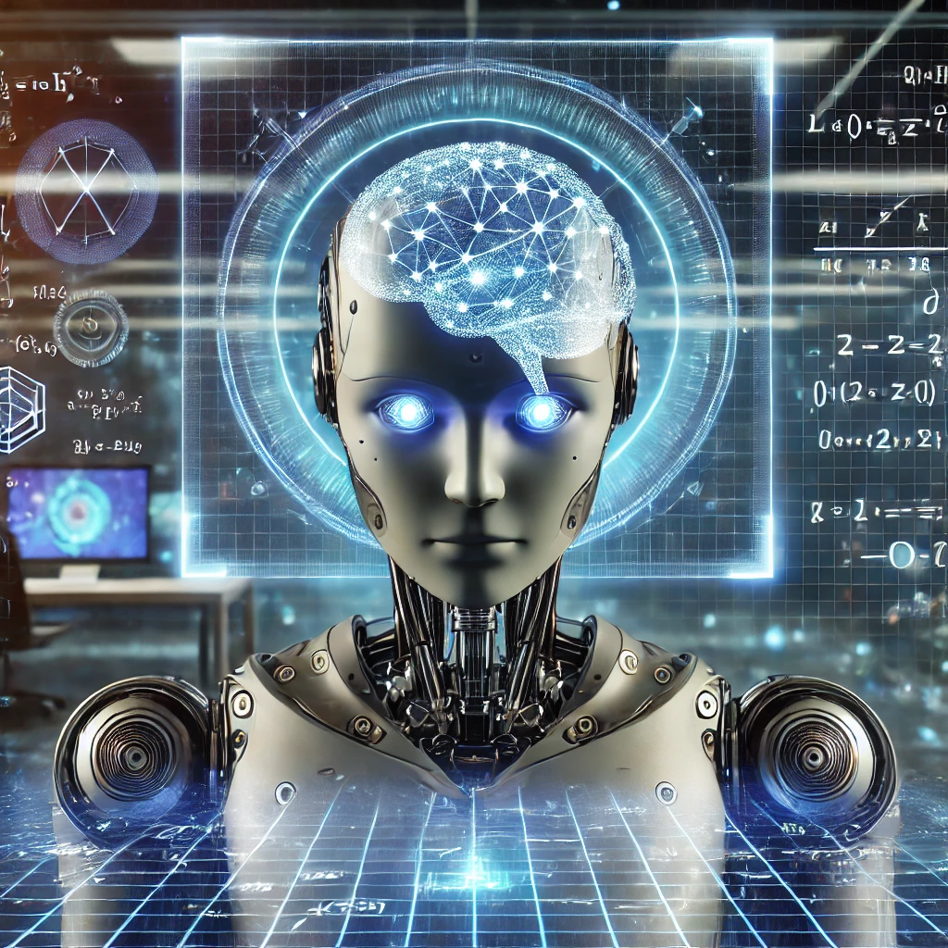
What is Artificial Intelligence (AI)
Machines that can learn and solve problems as humans do

Slide 3
Applications of AI
•Healthcare
•Material design
•Self-driving cars
•Finance
•Cybersecurity
•Strategic games, video games
•Military simulation
•Advertising, marketing
•Natural language processing, translation, etc
•Speech recognition, pattern recognition
•Virtual reality
•Robotics

Slide 4

Short History of AI (1)
The "Turing Test" was introduced as a concept by British mathematician and computer scientist Alan Turing in 1950 to determine whether a machine can exhibit intelligent behavior equivalent to, or indistinguishable from, that of a human.

Slide 5
Short History of AI (2)
Key Concepts and Tools
Artificial neural networks (~1950)
Machine learning
Deep learning (~1970)
Natural language processing
Text and data mining
Image and speech recognition
Generative AI
Large language models

Slide 6
Generative AI, ChatGPT and Similar Ones
ChatGPT holds a special place as the first of its kind, but there are around 30 AI alternatives for different purposes. Among them, the following serve the purpose of creating academic publications:
Bing AI – The best ChatGPT alternative for source citation
WriteSonic – The best ChatGPT alternative for writing unique content
Jasper – The best ChatGPT alternative for writing
Elicit – The best ChatGPT alternative for research

Slide 7
Generative AI
This is a type of AI that uses Machine Learning techniques to identify patterns in large data sets, and uses them to generate new text, image, music, code, etc. It can be used to:
– Generate text
– Create summaries, abstracts, keywords
– Assist literature search
– Generate or simplify language, methods, tables, figures, formulas
– Translate
– Detect and correct errors
– Detect plagiarism

Slide 8
Verification of Statistical Data
Statcheck
https://michelenuijten.shinyapps.io/statcheck-web/
It is used to check a pdf, docx or html file for errors in statistical reporting
It is an R package
It is designed firstly for phycology articles. Therefore report results are in accordance with the guidelines published by the American Psychological Association.
This is a limitation for applied economic research articles.

Slide 9
AI and journal publishing
Language processing
Assist researchers in tasks like paper writing
Major academic publishers such as Elsevier, Springer Nature, Taylor & Francis are collaborating with software companies to develop AI tools for application in academic journal publishing.
With the advancement of Generative AI, the use of AI in journals is expected to rapidly expand.

Slide 10
First Example of a Scholarly Book Written by AI
Springer, 2019, 247 pages
https://link.springer.com/book/10.1007/978-3-030-16800-1
Beta Writer, Goethe University Frankfurt/Main
Summarize about 150 papers published from 2016 to 2018 and provide an overview of the chemistry field

Slide 11
Nature’s 10, 2023
Since its launch over a decade ago, Nature’s 10 has recognized the impact of ten individuals in the scientific community. In 2023, for the first time, a non-human entity was included in the list, highlighting the growing role of artificial intelligence, designed to emulate human language, in advancing scientific research and innovation.

Slide 12
