Slide 1
Econometrics
February 2025

Slide 2
Part V
Heteroskedasticity and
Homoskedasticity for Simple Regression

Slide 3
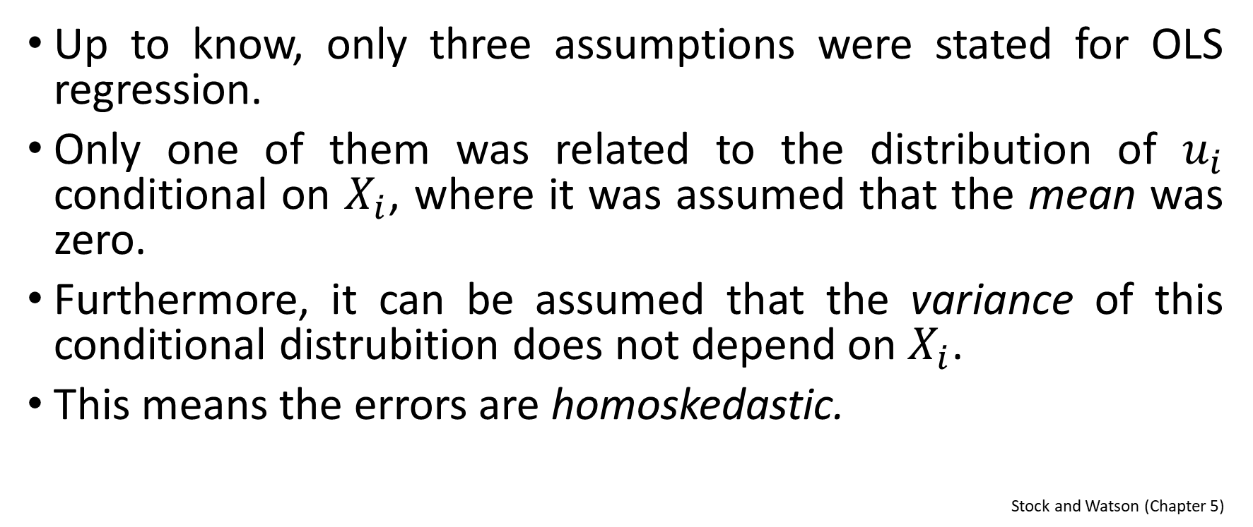
Heteroskedasticity and Homoskedasticity (1)
Up to know, only three assumptions were stated for OLS regression.
Only one of them was related to the distribution of $u_{i}$ conditional on $X_{i}$, where it was assumed that the mean was zero.
Furthermore, it can be assumed that the variance of this conditional distrubition does not depend on $X_{i}$.
This means the errors are homoskedastic.
Stock and Watson (Chapter 5)

Slide 4
Heteroskedasticity and Homoskedasticity (2)
Definitions of Heteroskedasticity and Homoskedasticity
If var(u|X=x) is constant – that is, if the variance of the conditional distribution of u given X does not depend on X – then u is said to be homoskedastic.
Otherwise, u is heteroskedastic.
Stock and Watson (Chapter 5)

Slide 5
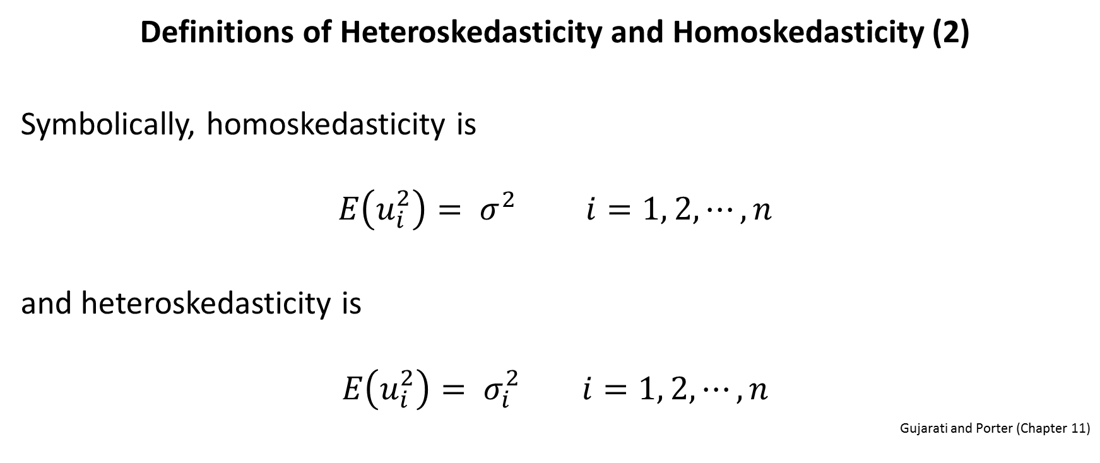
Heteroskedasticity and Homoskedasticity (3)
Definitions of Heteroskedasticity and Homoskedasticity (2)
Symbolically, homoskedasticity is
$$E\left(u_{i}^{2}\right)= σ^{2} i=1, 2, ⋯, n$$
and heteroskedasticity is
$$E\left(u_{i}^{2}\right)= σ_{i}^{2} i=1, 2, ⋯, n$$
Gujarati and Porter (Chapter 11)

Slide 6
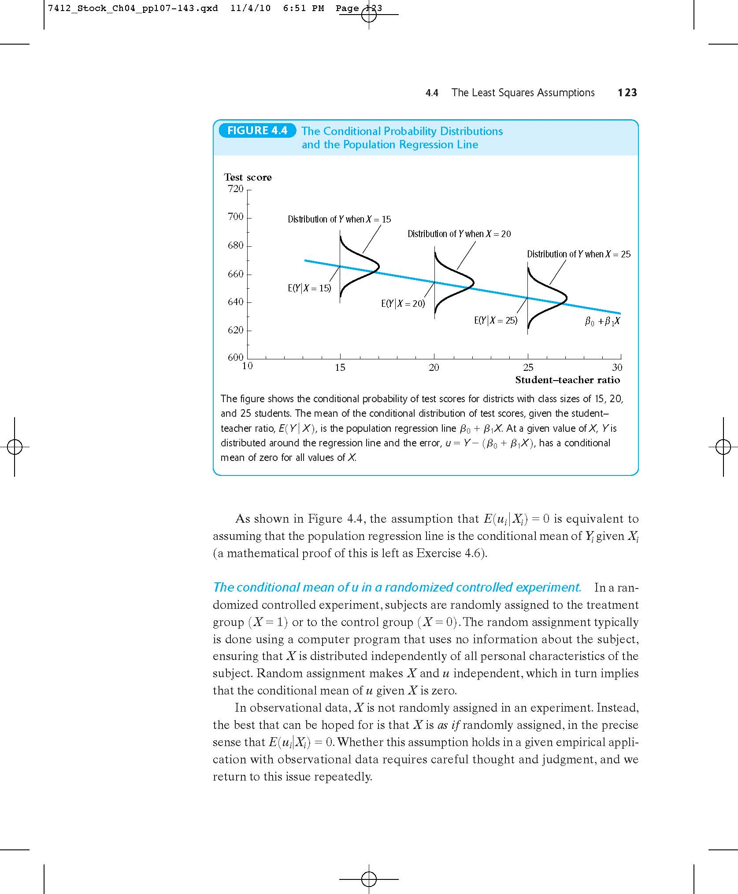
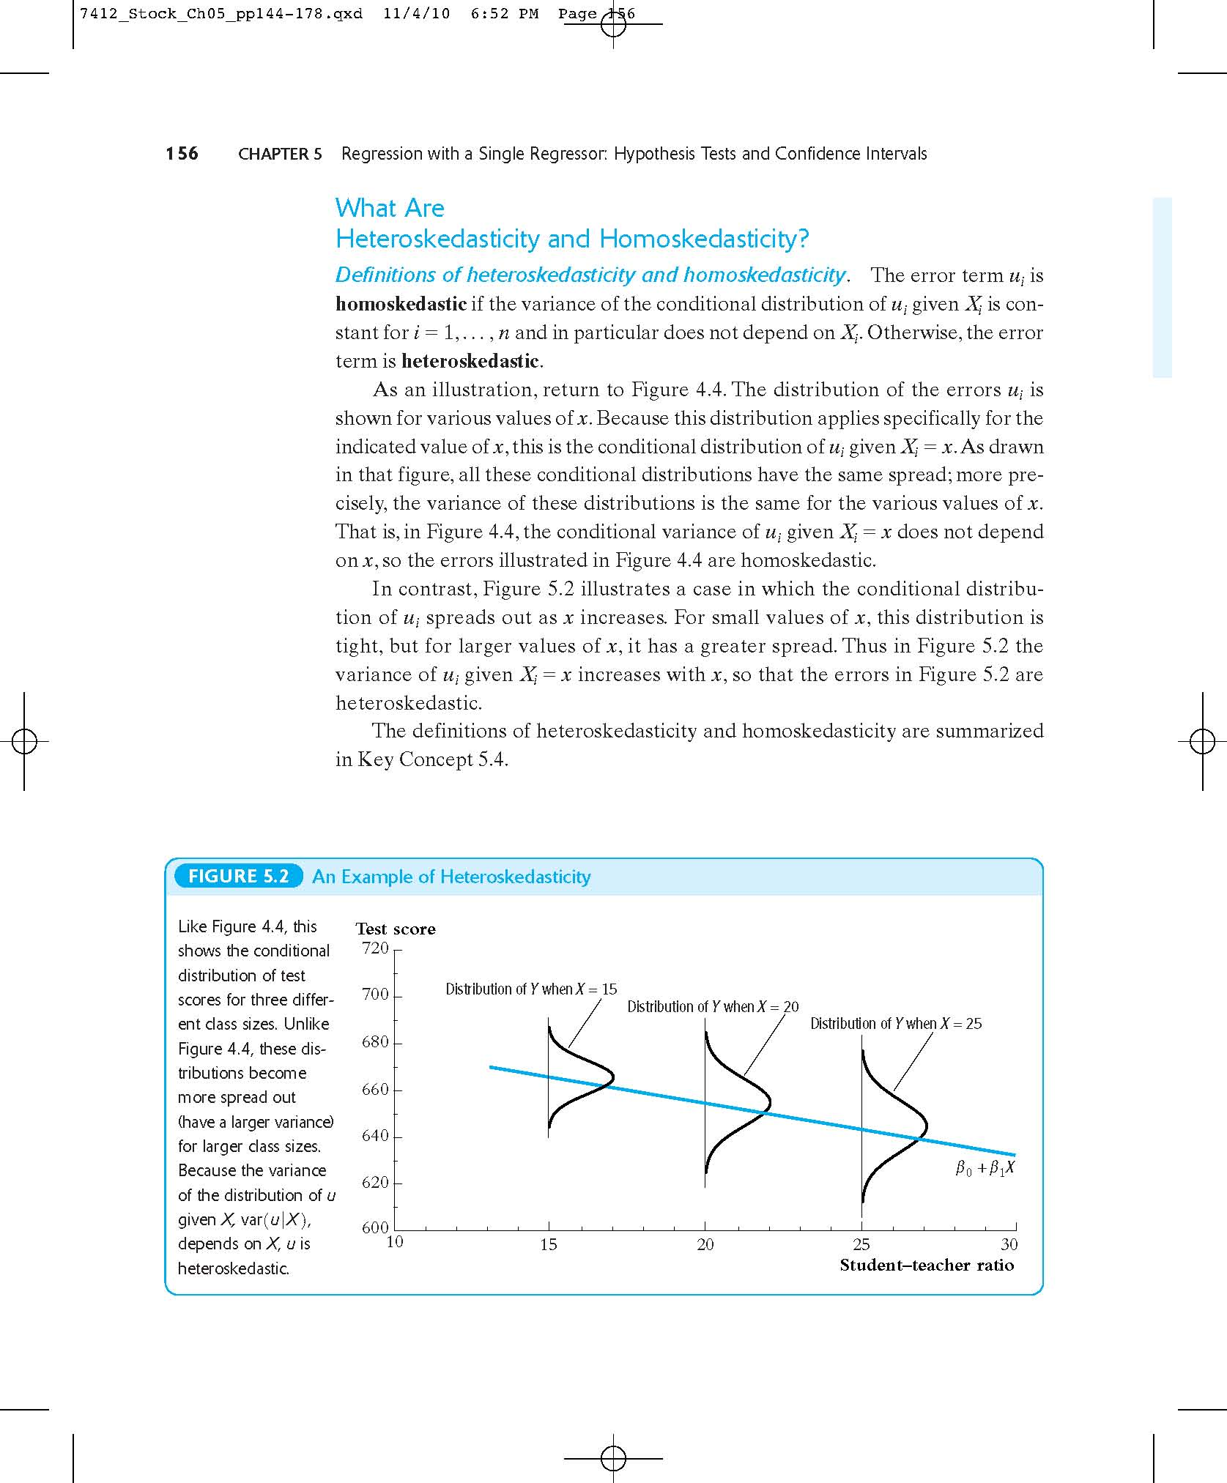
Heteroskedasticity and Homoskedasticity (4)
Homoskedasticity in a Picture
Heteroskedasticity in a Picture
All the conditional distributions have the same spread; the variance of these distributions is the same for the various values of x.
The conditional distributions different spread; the variance of these distributions is different for the various values of x.
Stock and Watson (Chapter 5)

Slide 7

Heteroskedasticity and Homoskedasticity (5)
Example 1: The Gender Gap in Earnings of College Graduates
Consider the earnings of male versus female university graduates with the following dummy variable regression model:
${Earnings}_{i}=β_{0}+β_{1}{MALE}_{i}+u_{i} i=1, 2, ⋯, n$.
where
$${MALE}_{i}=\left\{\begin{matrix}1 if male \\ 0 if female \end{matrix}\right.$$
Stock and Watson (Chapter 5)

Slide 8
Heteroskedasticity and Homoskedasticity (6)
Example 1: The Gender Gap in Earnings of College Graduates
Is the variance of the error term the same for male and female?
If the answer is «yes», the error is homoskedastic.
If the answer is «no», the error is heteroskedastic.
Stock and Watson (Chapter 5)

Slide 9
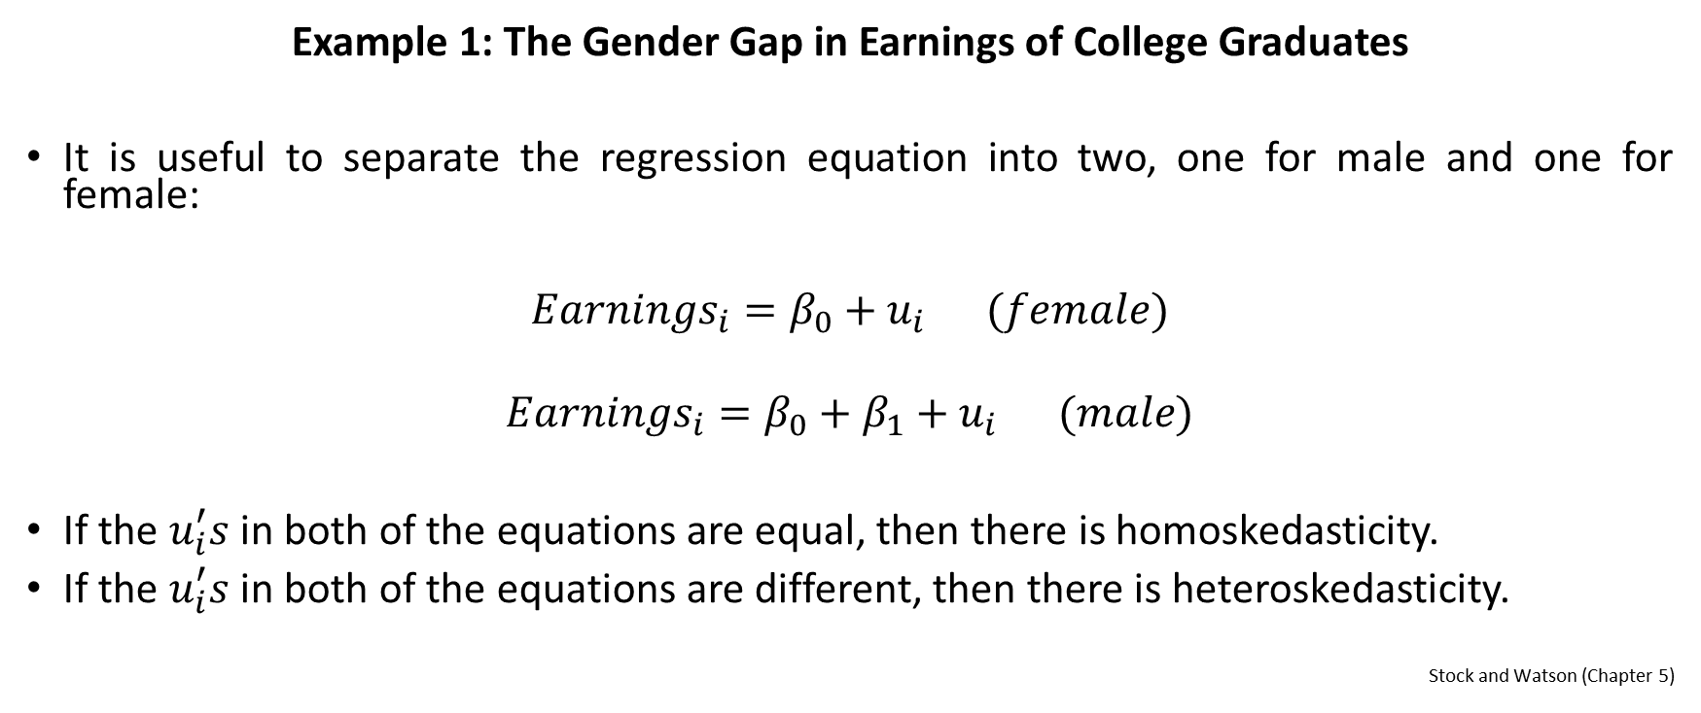
Heteroskedasticity and Homoskedasticity (7)
Example 1: The Gender Gap in Earnings of College Graduates
It is useful to separate the regression equation into two, one for male and one for female:
${Earnings}_{i}=β_{0}+u_{i} (female)$
$${Earnings}_{i}=β_{0}+β_{1}+u_{i} (male)$$
If the $u_{i}^{′}s$ in both of the equations are equal, then there is homoskedasticity.
If the $u_{i}^{′}s$ in both of the equations are different, then there is heteroskedasticity.
Stock and Watson (Chapter 5)

Slide 10

Heteroskedasticity and Homoskedasticity (8)
Example 1: The Gender Gap in Earnings of College Graduates
Which is more realistic? Homoskedasticity or Hetoroskedasticity?
There are always poorly paid men, but there have rarely been highly paid women. This suggests that the distribution of earnings among women is tighter than among men.
In other words, the variance of the error term in
${Earnings}_{i}=β_{0}+u_{i} (female)$
is plausibly less than the variance of the error term in
$${Earnings}_{i}=β_{0}+β_{1}+u_{i} (male)$$
This suggests that the error term in the binary variable regression model
$${Earnings}_{i}=β_{0}+β_{1}{MALE}_{i}+u_{i}$$
is heteroskedastic.
Stock and Watson (Chapter 5)

Slide 11
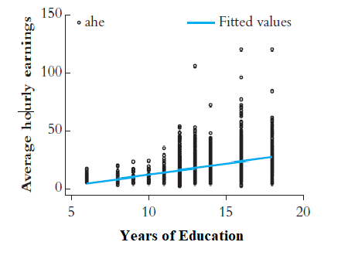
Heteroskedasticity and Homoskedasticity (9)
Example 2: The Economic Value of a Year of Education
The spread of the distribution of earnings increases with the years of education.
While some workers with many years of education have low-paying jobs, very few workers with low levels of education have high-paying jobs.
This suggestests that the error term is hetoroskedastic.

