Slide 1
Econometrics
March 2025

Slide 2
Part VII
Hypothesis Tests and Model Specification in Multiple Regression

Slide 3
Introduction
One new possibility that arises in multiple regression, which is different than the simple regression, is a hypothesis that simultaneously involves two or more regression coefficients.
The general approach to testing such «joint» hypothesis involves a new test statistic, the F-statistic.
Stock and Watson (Chapter 7)

Slide 4
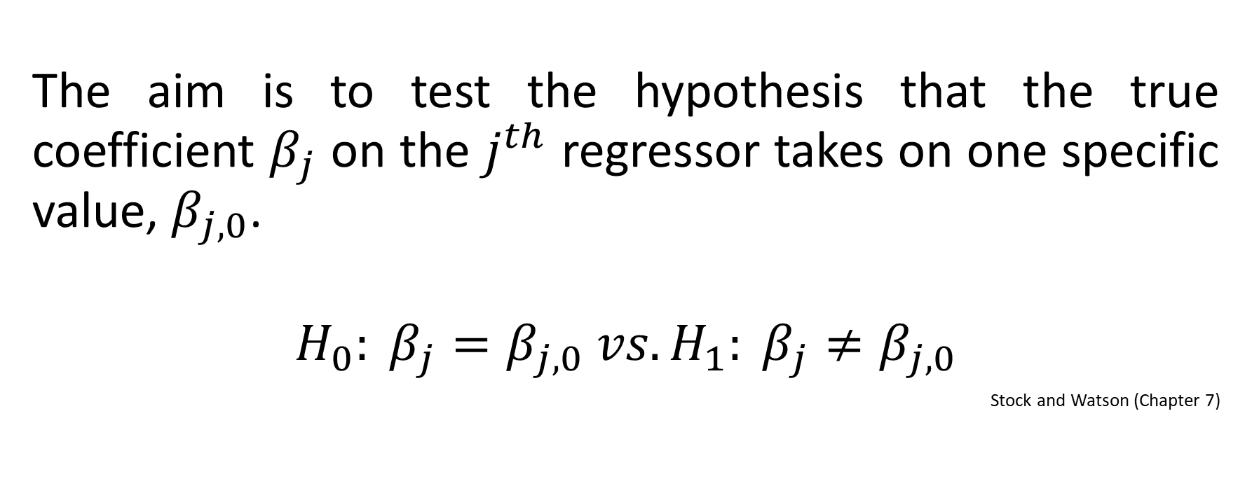
Hypothesis for a Single Coefficient
The aim is to test the hypothesis that the true coefficient $β_{j}$ on the $j^{th}$ regressor takes on one specific value, $β_{j,0}$.
$$H_{0}: β_{j}=β_{j,0} vs. H_{1}: β_{j}≠β_{j,0}$$
Stock and Watson (Chapter 7)

Slide 5
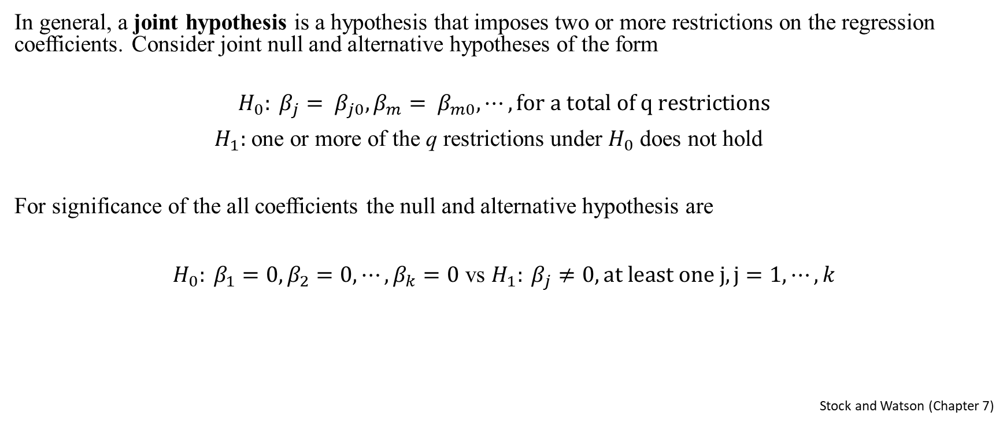
Hypothesis for Multiple Coefficients
In general, a joint hypothesis is a hypothesis that imposes two or more restrictions on the regression coefficients. Consider joint null and alternative hypotheses of the form
$$H_{0}: β_{j}= β_{j0},β_{m}= β_{m0}, ⋯, for a total of q restrictions$$
$H_{1}:$ one or more of the q restrictions under $H_{0}$ does not hold
For significance of the all coefficients the null and alternative hypothesis are
$H_{0}: β_{1}=0,β_{2}=0, ⋯,β_{k}=0$ vs $H_{1}: β_{j}≠0, at least one j, j=1, ⋯,k$
Stock and Watson (Chapter 7)

Slide 6
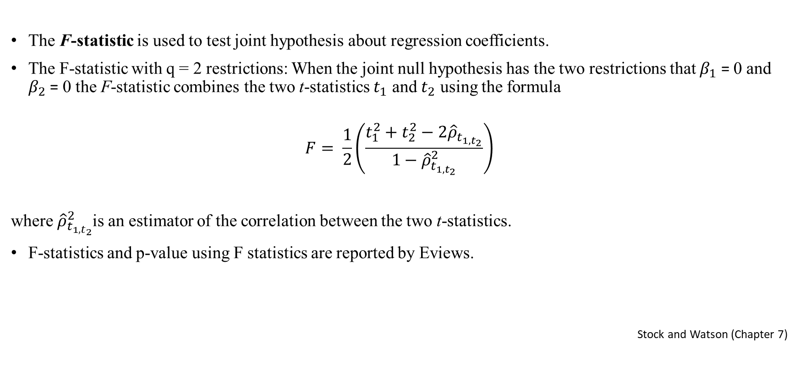
F Statistics
The F-statistic is used to test joint hypothesis about regression coefficients.
The F-statistic with q = 2 restrictions: When the joint null hypothesis has the two restrictions that $β_{1}$ = 0 and $β_{2}$ = 0 the F-statistic combines the two t-statistics $t_{1}$ and $t_{2}$ using the formula
$$F= \frac{1}{2}\left(\frac{t_{1}^{2}+t_{2}^{2}−2{\hat{ρ}}_{t_{1,t_{2}}}}{1−{\hat{ρ}}_{t_{1,t_{2}}}^{2}}\right)$$
where ${\hat{ρ}}_{t_{1,t_{2}}}^{2}$is an estimator of the correlation between the two t-statistics.
F-statistics and p-value using F statistics are reported by Eviews.
Stock and Watson (Chapter 7)

Slide 7
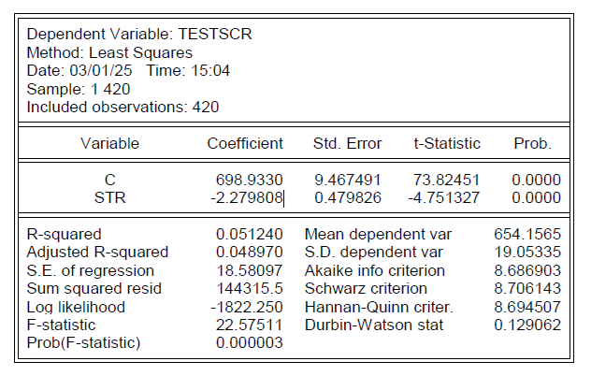
Eviews Application (1)

Slide 8
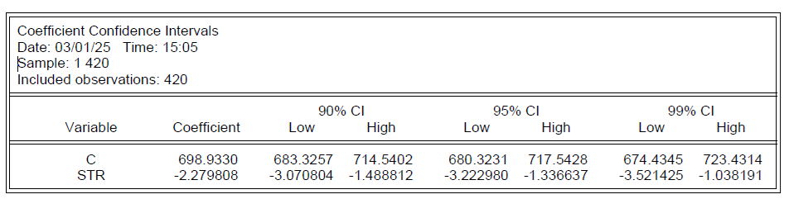
Eviews Application (2)

Slide 9
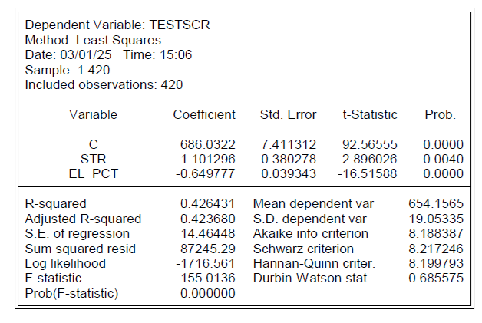
Eviews Application (3)

Slide 10
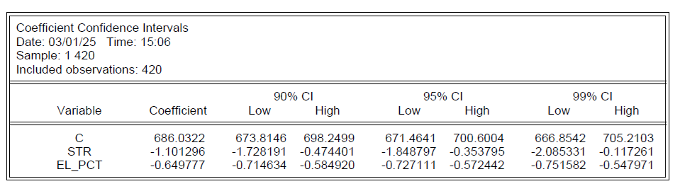
Eviews Application (4)

Slide 11
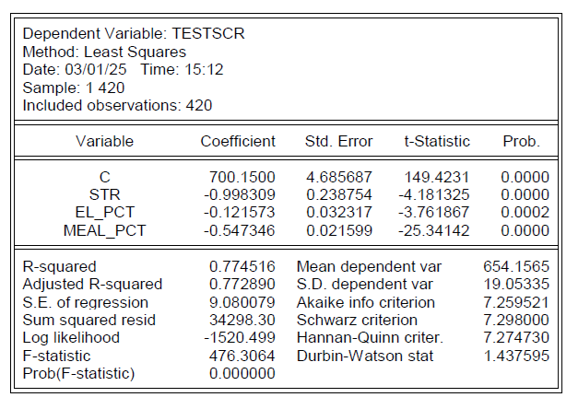
Eviews Application (5)

Slide 12
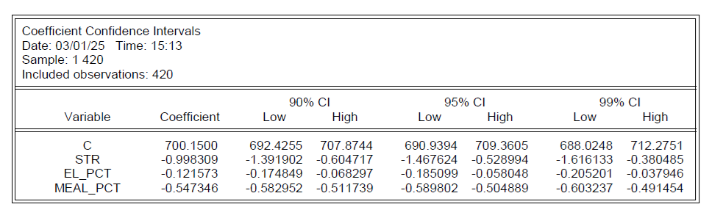
Eviews Application (6)

Slide 13
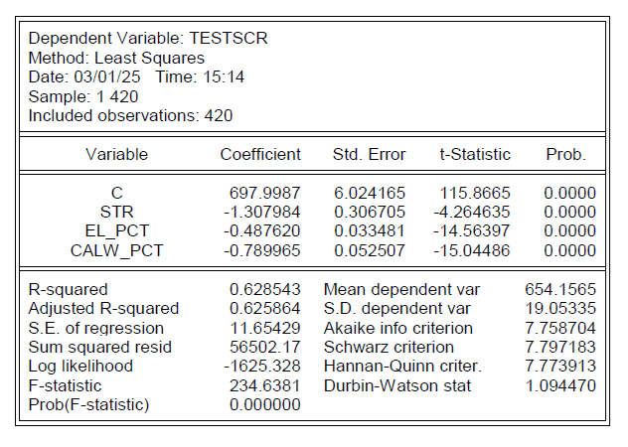
Eviews Application (7)

Slide 14
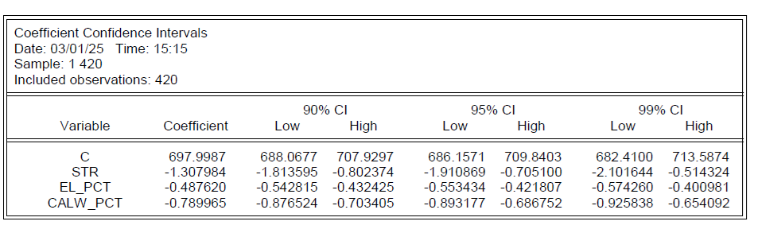
Eviews Application (8)

Slide 15
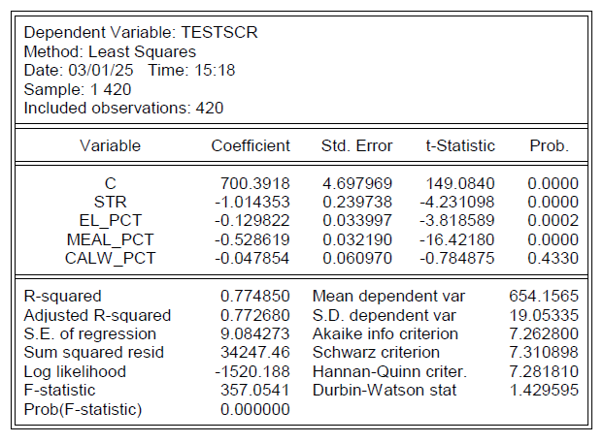
Eviews Application (9)

Slide 16
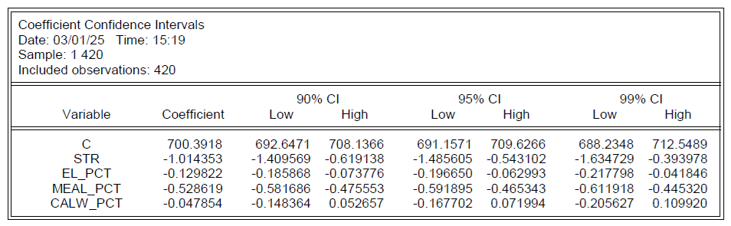
Eviews Application (10)

Slide 17
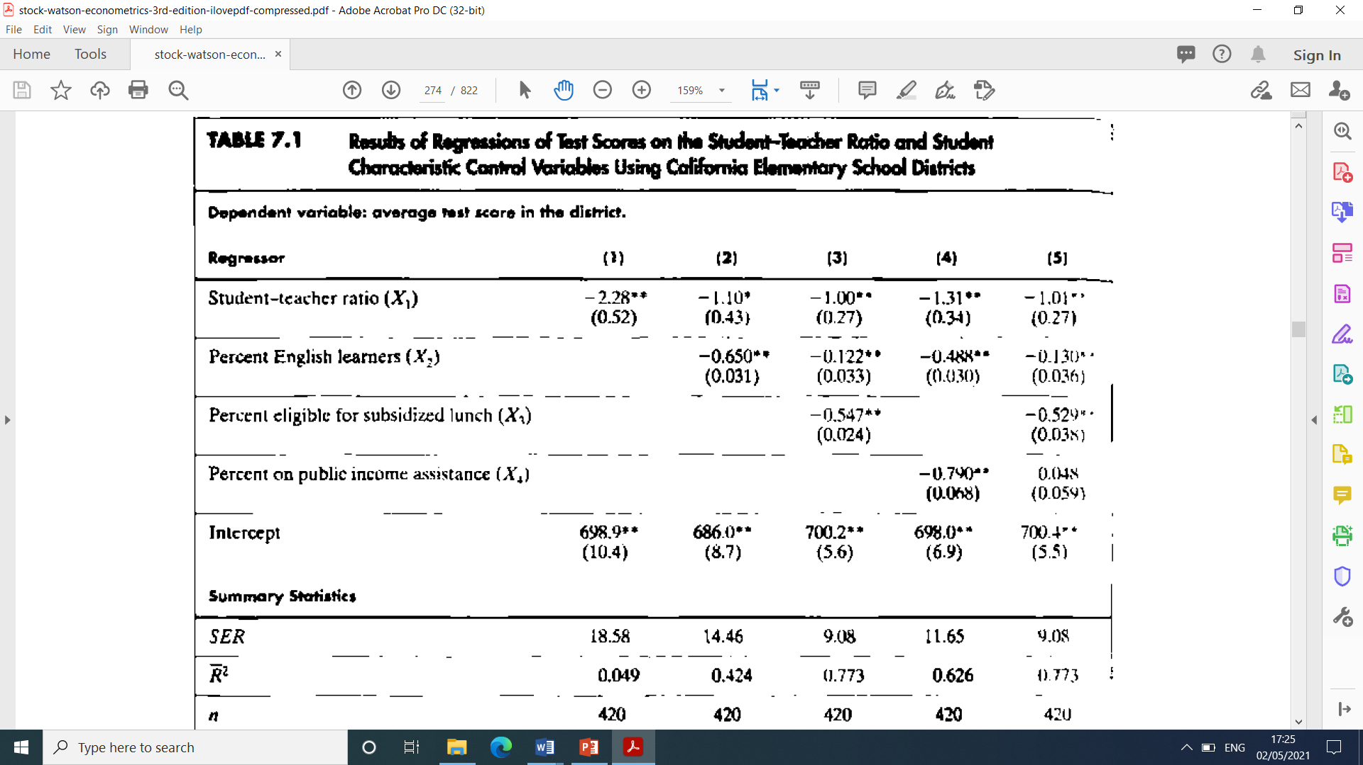
Analysis of the Models

