Slide 1
Econometrics Nonlinear Functions
March 2025

Slide 2
Linear Regression Functions
The regression functions that we studied so far were linear.
SQ: How do we understand that a function is linear?

Slide 3
Linear Functions
The slope is constant.
That is the effect of a change in X on Y is same every where.
Y
X

Slide 4
Nonlinear Functions
The slope is not constant.
That is the effect of a change in X on Y is different for different values of X.
Y

Slide 5
But the linear approximation is not always a good one.

Slide 6
Example
Let X be student per teacher.
Let Y be the average test score.
Let the class size is small.
Reducing student per teacher by one have a great effect.
Let the class size is large.
Reducing student per teacher by one have a little effect.

Slide 7
Two Groups of Methods for Detecting and Modelling Nonlinear Regression Functions (1)
First Group
The effect on the dependent variable of a change in one independent variable depends on the value of the independent variable itself.
Example: Reducing class sizes by one student per teacher might have a greater effect if class sizes are already manageably small than if they are so large that the teacher can do little more than keep the class under control.
(Stock & Watson, Chapter 8)
SQ: Look at slide 4 again. Tell which region is manageable and in which region little can be done.

Slide 8


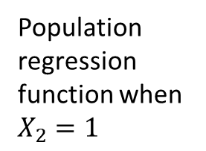
Two Groups of Methods for Detecting and Modelling Nonlinear Regression Functions (2)
Second Group
The effect on the dependent variable of a change in one independent variable depends on the value of another independent variable.
Example: Students still learning English might especially benefit from having more on-to-one attention. Therefore, the effect on test scores of reducing the student-teacher ratio will be greater in districts with many students still learning English than in districts with few English learners.
(Stock & Watson, Chapter 8)
Population regression
function when $X_{2}=0$
Y
Population regression function when $X_{2}=1$
$$X_{1}$$

Slide 9
Nonlinear Functions of a Single Independent Variable
Polynomials in X
The population regression function is approximated by a quadratic, cubic, or higher-degree polynomial.
Logarithmic transformations
Y and/or X is transformed by taking its logarithm
This gives a “percentages” interpretation that makes sense in many applications
(Stock & Watson, Chapter 8)
SQ: What do you understand when we say “percentages interpretation”?

Slide 10

Polynomials in X
The polynomial regression model of degree r is:
$Y_{i}=β_{0}+β_{1}X_{i}+β_{2}X_{i}^{2}+⋯+β_{r}X_{i}^{r}+u_{i}, i=1, ⋯,N$
When r = 2 → Quadratic
When r = 3 → Cubic

Slide 11
Interpreting the Coefficients
Estimate the function.
Compute “effects” for different values of the independent variable X.
Predict the change in the dependent variable Y for a change in the independent variable X.
Change in X | Change in Y
From 5 to 6 | 3.4
From 25 to 26 | 1.7
From 45 to 46 | 0

Slide 12
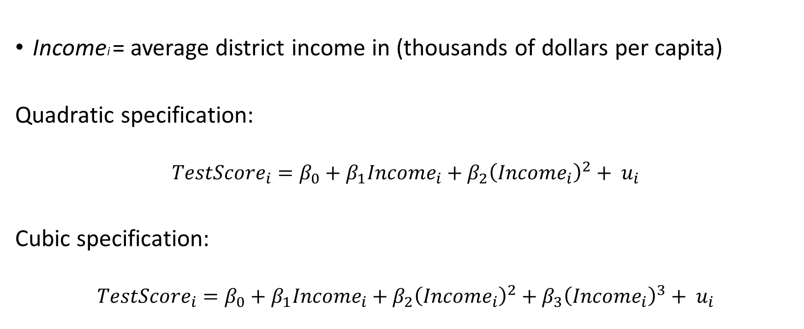
Example: The Test Score-Income Relation
Incomei = average district income in (thousands of dollars per capita)
Quadratic specification:
$${TestScore}_{i}=β_{0}+β_{1}{Income}_{i}+β_{2}{\left({Income}_{i}\right)}^{2}+ u_{i}$$
Cubic specification:
$${TestScore}_{i}=β_{0}+β_{1}{Income}_{i}+β_{2}{\left({Income}_{i}\right)}^{2}+β_{3}{\left({Income}_{i}\right)}^{3}+ u_{i}$$

Slide 13
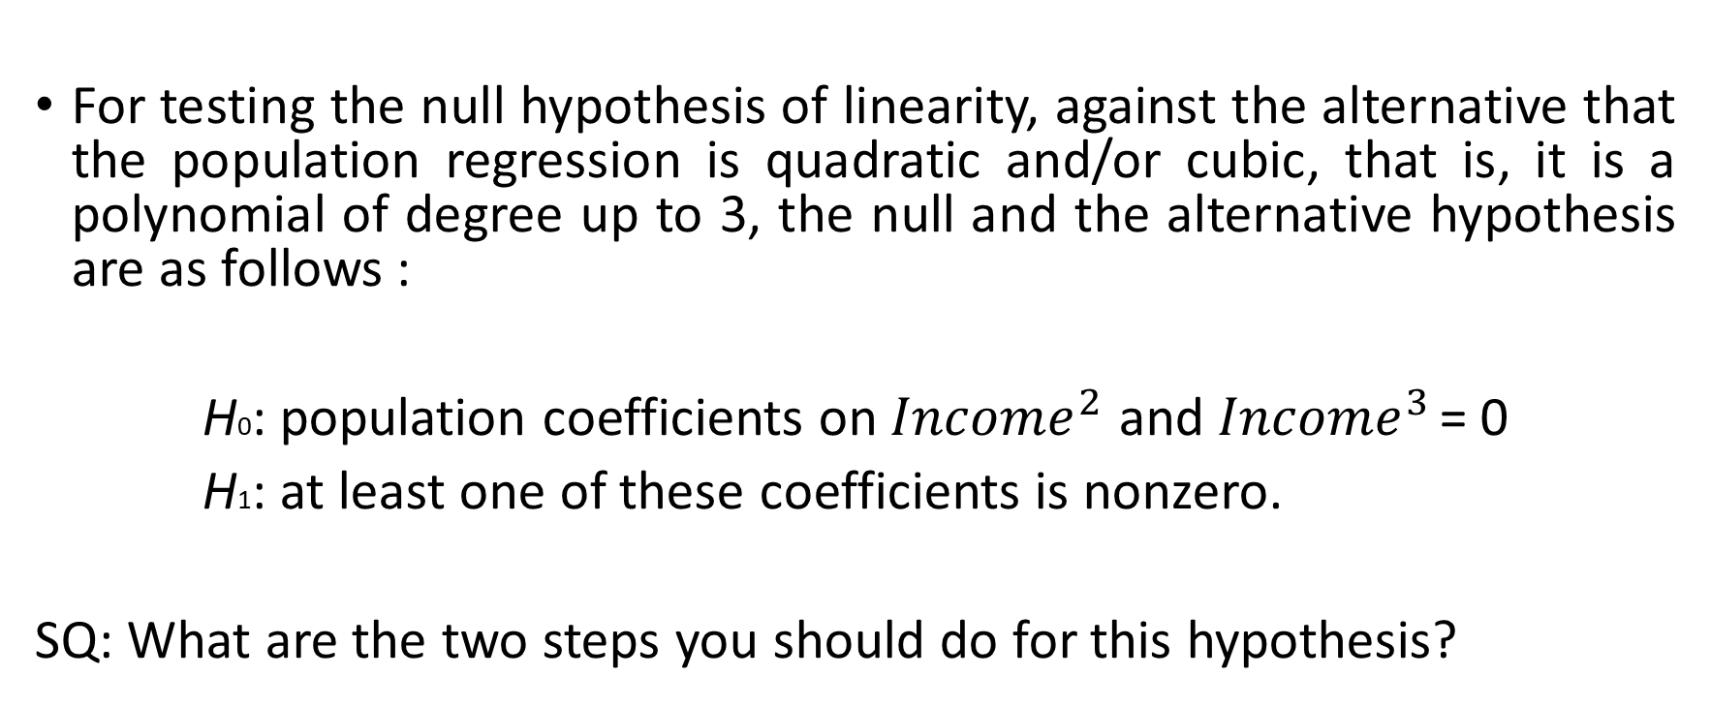
Hypothesis Testing of Linearity (1)
For testing the null hypothesis of linearity, against the alternative that the population regression is quadratic and/or cubic, that is, it is a polynomial of degree up to 3, the null and the alternative hypothesis are as follows :
H0: population coefficients on ${Income}^{2}$ and ${Income}^{3}$ = 0
H1: at least one of these coefficients is nonzero.
SQ: What are the two steps you should do for this hypothesis?

Slide 14
Hypothesis Testing of Linearity (2)
You have to make F-test for this joint hypothesis.
If you reject the null hypothesis you have to make individual t-tests for each coefficient.

Slide 15
Summary: Polynomial Regression Functions
Estimation of coefficients by OLS.
Interpret the coefficients. (Ploting the predicted values can help for interpretation)
Compute predicted ΔY/ΔX at different values of X.
•Make F and t tests for determining the degree of the polynomial, r.

Slide 16
Logorithmic Functions of Y and/or X
ln(X) = the natural logarithm of X
Logarithmic transforms permit modelling relations in “percentage” terms rather than linearly.
Stock & Watson, Chapter 8

Slide 17
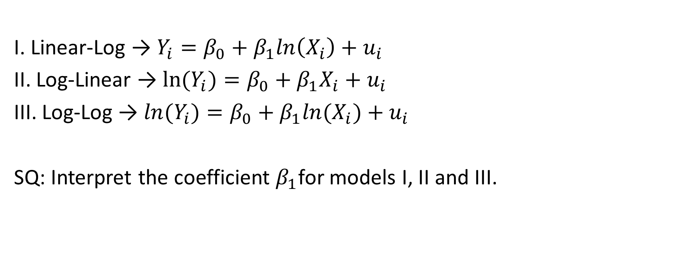
The Three Log Regression Specifications
I. Linear-Log → $Y_{i}=β_{0}+β_{1}ln\left(X_{i}\right)+u_{i}$
II. Log-Linear → $ln(Y_{i})=β_{0}+β_{1}X_{i}+u_{i}$
III. Log-Log → $ln(Y_{i})=β_{0}+β_{1}ln⁡(X_{i})+u_{i}$
SQ: Interpret the coefficient $β_{1}$for models I, II and III.

Slide 18
Interpretation of the coefficient for the Three Log Regression Specifications
Linear-Log Case:
A percentage change in X → Change in Y
Log-Linear Case:
Change in X → Percentage change in Y
Log-Log Case:
Percentage change in X → Percentage change in Y
SQ: Interpretation of Log-Log Case resembles to what in economics?

Slide 19
If Nonlinearity Comes from Parameters
Models that are nonlinear in one or more parameters can be estimated by nonlinear least squares (NLS) (but not by OLS).

