Slide 1
Econometrics Model Selection
March 2025

Slide 2
LEARNING OUTCOMES
Recognize the significance of choosing the right model for making economic decisions
Acquire knowledge about several criteria used for selecting models
Gain an understanding of the theory-based approach to model selection
Comprehend the impact of relaxing the assumption of normality in error terms in econometric models on the process of model selection

Slide 3
OUTLINE
INTRODUCTION
MECHANICAL CHOICE METHODS OF MODEL SELECTION
THEORY BASED MODEL SELECTION APPROACH
NON-NORMAL ERROR TERMS

Slide 4
INTRODUCTION (1)
The process of model selection is of great significance and is a common challenge in applied economics. Why?
The number of models that need to be considered is extensive.
The accuracy of forecasts, conclusions, and interpretations relies heavily on the specific model chosen.

Slide 5
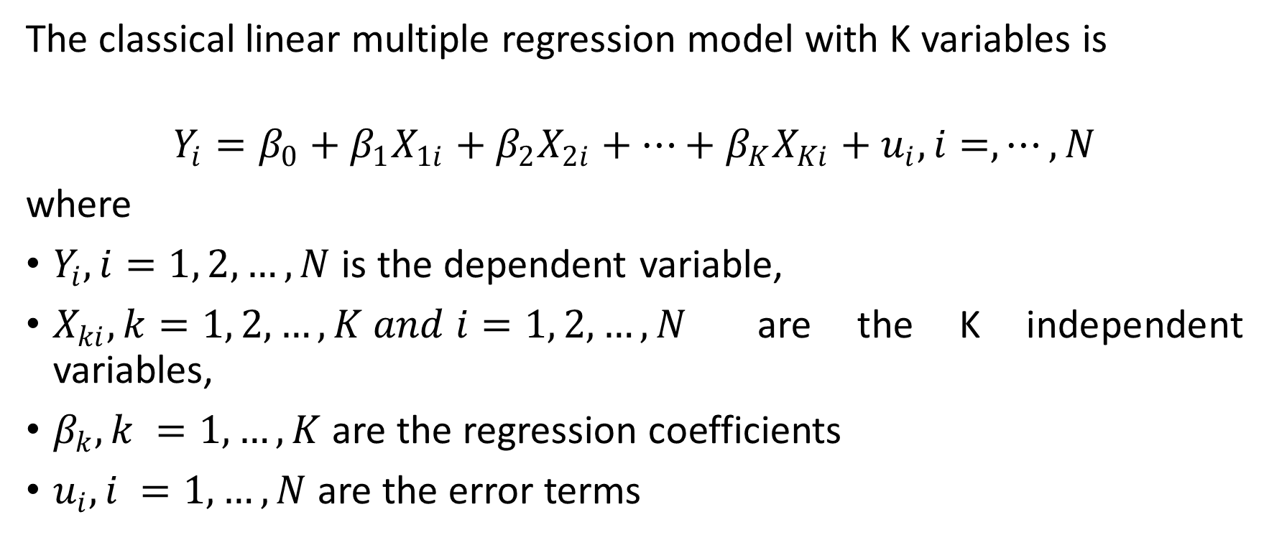
INTRODUCTION (2)
The classical linear multiple regression model with K variables is
$$Y_{i}=β_{0}+β_{1}X_{1i}+β_{2}X_{2i}+⋯+β_{K}X_{Ki}+u_{i}, i=,⋯,N$$
where
$Y_{i}, i=1, 2, …, N$ is the dependent variable,
$X_{ki}, k=1, 2, …, K and i=1, 2, …, N$ are the K independent variables,
$β_{k}, k =1, …, K$ are the regression coefficients
$u_{i}, i =1, …, N$ are the error terms

Slide 6
INTRODUCTION (3)
One of the assumptions in this model is that the analysis relies on a precisely specified model. If the model is not adequately specified, it leads to the problem of model specification error or model specification bias.

Slide 7
INTRODUCTION (4)
During the development of an empirical model, it is probable to make one or more of the following specification errors:
Neglecting to include a relevant variable(s)
Including an unnecessary variable(s)
Assuming that the error term follows a normal distribution

Slide 8
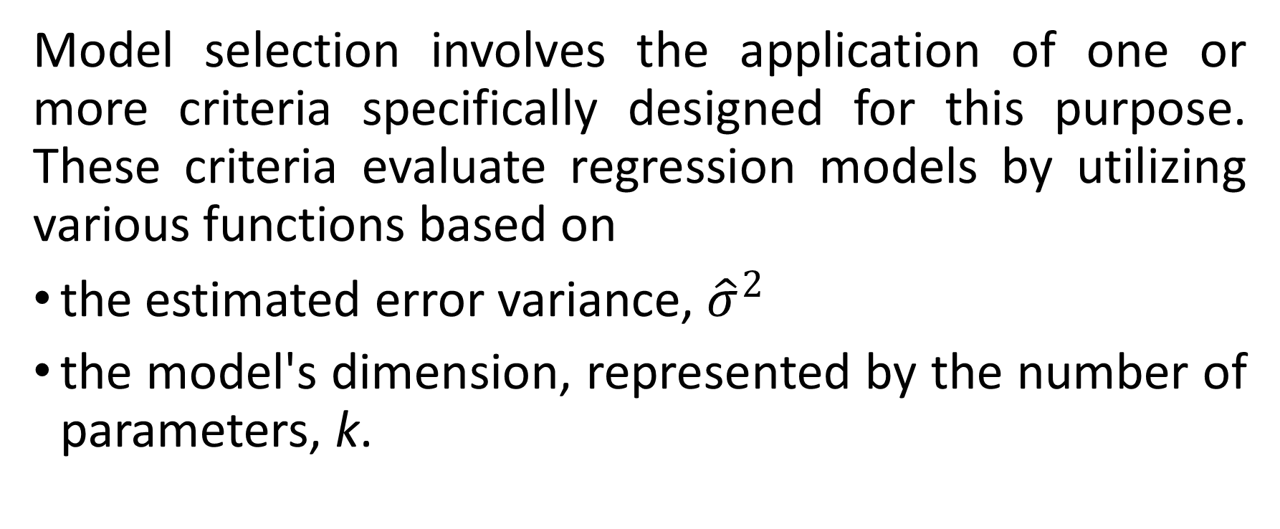
MECHANICAL CHOICE METHODS OF MODEL SELECTION (1)
Model selection involves the application of one or more criteria specifically designed for this purpose. These criteria evaluate regression models by utilizing various functions based on
the estimated error variance, ${\hat{σ}}^{2}$
the model's dimension, represented by the number of parameters, k.

Slide 9
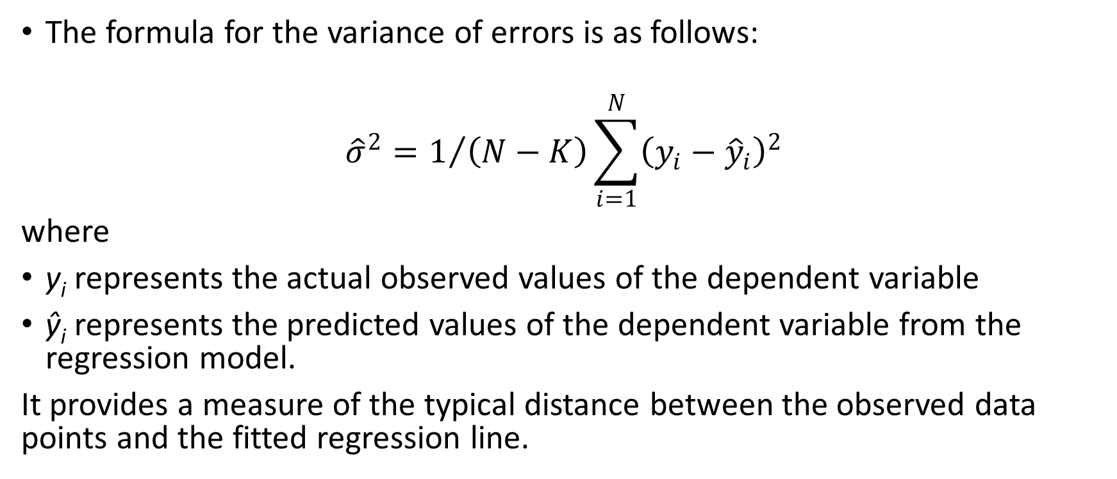
MECHANICAL CHOICE METHODS OF MODEL SELECTION (2)
The formula for the variance of errors is as follows:
$${\hat{σ}}^{2}=1/{\left(N−K\right)}\sum_{i=1}^{N}{{\left(y_{i}−{\hat{y}}_{i}\right)}^{2}}$$
where
y_{i} represents the actual observed values of the dependent variable
ŷ_{i} represents the predicted values of the dependent variable from the regression model.
It provides a measure of the typical distance between the observed data points and the fitted regression line.

Slide 10
MECHANICAL CHOICE METHODS OF MODEL SELECTION (3)
The widely recognized model selection criteria are:
Akaike Information Criterion (AIC; Akaike, 1973; Akaike, 1974)
Schwarz Criterion (SC; Schwarz, 1978; Rissanen, 1978)
Hannan-Quinn Criterion (HQC; Hannan and Quinn, 1979; Quinn, 1980)

Slide 11
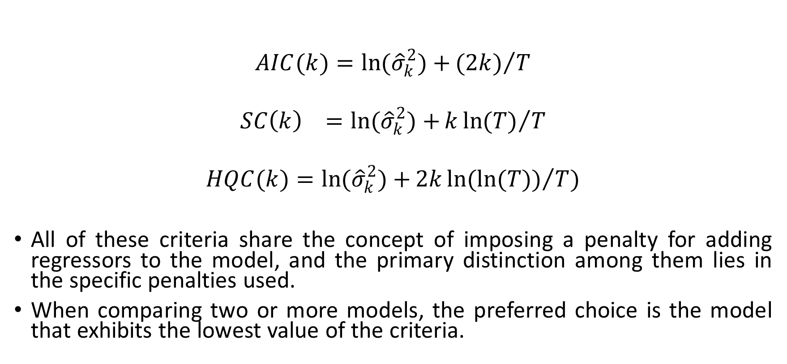
MECHANICAL CHOICE METHODS OF MODEL SELECTION (4)
$$AIC(k)=\ln{({\hat{σ}}_{k}^{2})+}{(2k)}/T$$
$$SC\left(k\right) =\ln{({\hat{σ}}_{k}^{2})+}k{\ln{(T)}}/T$$
$$HQC(k)=\ln{{(\hat{σ}}_{k}^{2})+}2k\ln{({\ln{(T)})}/T})$$
All of these criteria share the concept of imposing a penalty for adding regressors to the model, and the primary distinction among them lies in the specific penalties used.
When comparing two or more models, the preferred choice is the model that exhibits the lowest value of the criteria.

Slide 12
THEORY BASED MODEL SELECTION APPROACH
Several authors, such as Amemiya (1980) and Judge et al. (1985), have raised concerns about the reliance on mechanical model selection procedures and have proposed a theory-based approach as an alternative.
They argue that models should be selected based on a solid theoretical foundation rather than solely relying on criteria or algorithms.
Hendry (1995) supports this notion and suggests starting with a complex model that encompasses all potential specifications, and then systematically simplifying it based on theoretical insights and empirical evidence.

Slide 13
NON-NORMAL ERROR TERMS (1)
In the majority of theoretical and empirical studies, it is commonly assumed that the error terms in econometric models follow a normal distribution.
However, financial data often exhibit skewness and kurtosis, deviating from the normal distribution assumption.
This poses a challenge for applied econometricians who need to understand how different model selection criteria perform under such circumstances.

Slide 14
NON-NORMAL ERROR TERMS (2)
Başçı and Zaman (1998) contributed to the understanding of how these criteria behave under more realistic assumptions and provided valuable guidance for econometric practitioners working with financial data.
They found that although skewness does not have much effect on the performance of criteria, kurtosis effects the performance of some of the criteria.

